Slide 1
Algorithmic Analysis

Slide 2
Efficiency
To compare the efficiency of the data structures.
It’s important to select the appropriate data structure for particular application.
Algorithm A is twice as fast as algorithm B?????

Slide 3
What is a Good Algorithm?
Efficient:
Running time
Space used
Efficiency as a function of input size:
The number of bits in an input number
Number of data elements (numbers, points)

Slide 4
Measuring the Running Time:
USING EXPERIMRNTAL STUDY
Write a program that implements the algorithm
Run the program with data sets of varying size and composition.
Use a method like System.currentTimeMillis() to get an accurate measure of the actual running time.

Slide 5
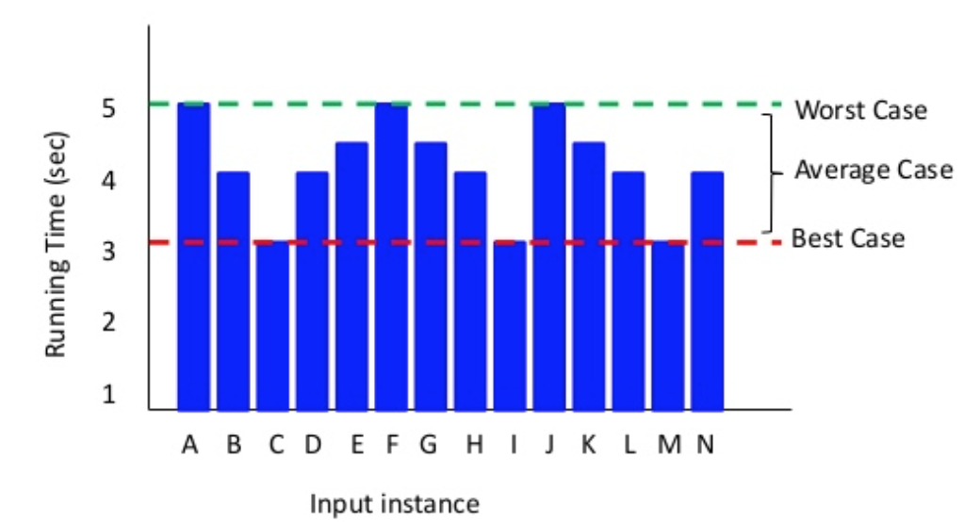
Binary Search: Repeated Results (dummy data)
https://www.slideshare.net/kunduanindita/ds1-intro-to-algo-asymptotic-analysis-insertion-sort-analysis

Slide 6
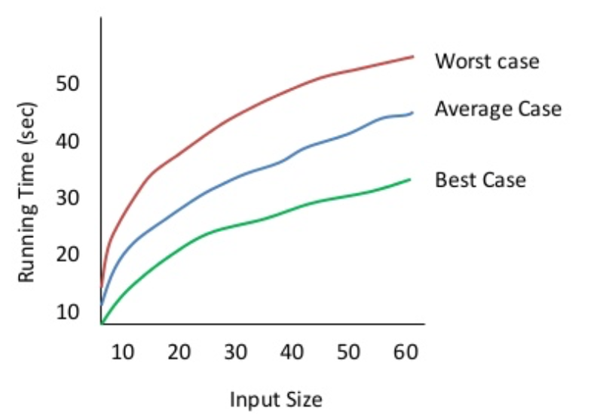
Best/Worst/Average Cases Scenarios II

Slide 7
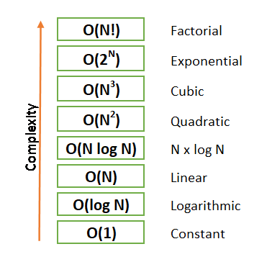

Slide 8
Best/Worst/Average Scenarios III
Worst case:
Is the upper bound of how bad a system can be
Mostly used
Often crucial to know: air traffic control or surgery
Average case
Considered as bad as worst case
Difficult to find rationally

Slide 9
Asymptotic Analysis
Refers to defining the mathematical bound/framing of an algorithm’s run-time performance.
Time required by an algorithm falls under three types:
Best: Minimum time required for program execution
Average: Average time required
Worst: Maximum time required

Slide 10
Asymptotic Analysis: Goals
Simplify analysis of running time:
Getting rid of details which may be affected by specific implementation and hardware
E.g.: 3n² to n²
Capturing the essence:
How the running time of an algorithm increases with the size of the input in the limit
Notes:
Exercises:
7n - 3
50 n log n
8n2 log n + 5 n2 + 600 n

Slide 11
Justification
Big O notation is a huge simplification; can we justify it?
It only makes sense for large problem sizes
Consider R = x² + 3x + 5 as x varies:
x | = | 0 | x2 | = | 0 | 3x | = | 10 | 5 | = | 5 | R | = | 5
x | = | 10 | x2 | = | 100 | 3x | = | 30 | 5 | = | 5 | R | = | 135
x | = | 100 | x2 | = | 10000 | 3x | = | 300 | 5 | = | 5 | R | = | 10,305
x | = | 1000 | x2 | = | 1000000 | 3x | = | 3000 | 5 | = | 5 | R | = | 1,003,005
x | = | 10,000 |  |  |  |  |  |  |  |  |  | R | = | 100,030,005

Slide 12
Basic Rules
Base of Logs ignored
log_{a}n = O(log n)
Power inside logs ignored
log(n²) = O(log n)
Base and powers in exponents not ignored
3^{n} is not O(2^{n})
Drop the leading constants
Ignore the lower order terms
Example:
Find the Big O complexity of an algorithm with the time complexity 3n³ + 4n + 2.
This simplifies to O(n³).

Slide 13
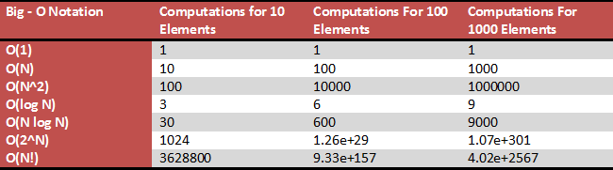

Slide 14
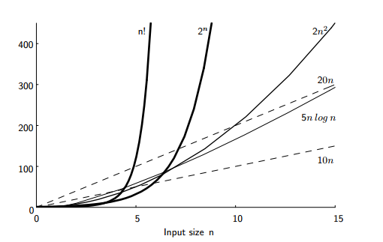

Slide 15
Special classes of algorithms:
Logarithmic: O(log n)
Linear: O(n)
Quadratic: O(n²)
Polynomial: O(n^{k}), k ≥ 1
Exponential: O(a^{n}), a > 1
Comparing asymptotic running times
an algorithm that runs in O(n) time is better than one that runs in O(n²) time
similarly, O(log n) is better than O(n)
hierarchy of functions: log n < n < n² <n³<2^{n}
Notes:
◻ “Relatives” of the Big-Oh ◻ (f(n)): Big Omega -asymptotic lower bound ◻ (f(n)): Big Theta -asymptotic tight bound

Slide 16
Time complexity of an algorithm
Time complexity of an algorithm signifies the total time required by the program to run to completion.
The time complexity of algorithms is most commonly expressed using the big o notation.

Slide 17
Statement;
Above we have a single statement.
Its Time Complexity will be constant.
The running time of the statement will not change in relation to N.

Slide 18
for(i=0; i < N; i++)
{
statement;
}
The time complexity for the above algorithm will be linear.
The running time of the loop is directly proportional to N.
When N doubles, so does the running time.

Slide 19
for(i=0; i < N; i++)
{
for(j=0; j < N;j++)
{
statement;
}
This time, the time complexity for the above code will be quadratic
The running time of the two loops is proportional to the square of N.
When N doubles, the running time increases by N * N

Slide 20
This algorithm to break a set of numbers into halves, to search a particular element.
This algorithm will have a logarithmic time complexity.
The running time of the algorithm is proportional to the number of times N can be divided by 2.
This is because the algorithm divides the working area in half with each iteration
while(low <= high)
{
mid = (low + high) / 2;
if (target < list[mid])
high = mid - 1;
else if (target > list[mid])
low = mid + 1;
else break;
}

Slide 21
How to find the time complexity of an algorithm
There are three steps you’ll want to take when calculating the time complexity of an algorithm:
List down all the basic operations in the code
Count the number of times each gets executed
Sum all the counts to get an equation

Slide 22
int sumup(int n)
return n* (n+1)/2;
int sumup(int n)
total=0;
for(int i=1;i<=n; n++){
total=total+i;
}
return total;

Slide 23
int sum=0;
for (int i=0; i<n; i++){
sum=sum+i;
}

Slide 24
initialize sum to 0
initialize i to 0;
while i<n do followings
add i to sum
increment i by 1
return sum

Slide 25
i=1
sum=0;
while(i<=n){
j=1;
while(j<=n){
sum=sum+1;
j=j+1;
}
i=i+1;
}

Slide 26
int sum=0;
for (int i=0; i<n; i++){
for (int j=0; j<n; j++){
sum=sum+i;
}
}

Slide 27
HOMEWORK

Slide 28
int sum=0;
for (int i=0; i<n; i++){
if (sum== 10){
sum=sum+2;
}
sum=sum+i;
}

Slide 29
int sum=0;
for (int i=0; i<n; i++){
for (int j=0; j<n; j++){
for (int j=0; j<n; j++){
sum=sum+i;
}
}
}

Slide 30
int sum=0;
for (int i=0; i<n; i++){
sum=sum+i;
}
for (int j=0; j<n; j++){
//some statements
}
for (int j=0; j<n; j++){
//some statements
}

Slide 31
int main()
{
int x, y;
printf("Enter Value of x ");
scanf("%d", &x);
printf("\nEnter Value of y ");
scanf("%d", &y);
int temp = x;
x = y;
y = temp;
printf("\nAfter the operation: x = %d, y = %d", x, y);
return 0;
}

Slide 32
Here’s a simple example that measures the time complexity of a for loop of size “n”:
int main(){
int n = 10;
int sum = 0;
for (int i=0; i<n; i++)
sum+=2;
cout =sum;
return 0;
}

Slide 33
Without Constant: Big O Notation
Algorithm | Running Time in Big O Notation
Linear Search | O (N)
Binary Search | O(log N)
Insertion to unordered array | O (1)
Insertion to ordered array | O (N)
Deletion in unordered array | O (N)
Deletion in ordered array | O (N)

Slide 34
Thank You

